Slide 1
Discrete & Continuous Random Variables (Probability distributions, PMF, PDF, CDF, JPDF,JPMF)
Instructor
Osama Bin Ajaz
Lecturer, S & H Dept.,
FAST-NU, Main Campus, Karachi
osama.ajaz@nu.edu.pk

Slide 2
Brief Content (Sessional – II)
Random Variables, Joint and marginal distributions.
Mathematical Expectation
Binomial & Multinomial distributions
Poisson, hypergeometric, geometric, and discrete uniform distributions.
Normal, Standard Normal, Exponential, Uniform and Chi-Sq. distributions.
Z-test & t-test

Slide 3
Random Variable
Two balls are drawn in succession without replacement from an urn containing 4 red balls and 3 black balls. The possible outcomes and the values y of the random variable Y , where Y is the number of red balls, are:
Suppose an experiment consists of tossing a coin two times & we are interested in the number of Heads (X):
Interest centers around the proportion of people who respond to a certain mail order solicitation. Let X be that proportion. X is a random variable that takes on all values x for which 0 ≤ x ≤ 1.
Notes:
S = { RR, RB, BR, BB} -> y = { 0, 1, 2}

Slide 4
Discrete & Continuous Random Variable
A random variable is called a discrete random variable if its set of possible outcomes is countable.
When a random variable can take on values on a continuous scale, it is called a continuous random variable

Slide 5
Discrete Probability Distribution
Tossing a coin 3 times and X = No. of heads
A shipment of 20 similar laptop computers to a retail outlet contains 3 that are defective. If a school makes a random purchase of 2 of these computers, find the probability distribution for the number of defectives.
Notes:
Tabular, formula and graphical forms. (3) X = No. of defective = {0, 1, 2}

Slide 6
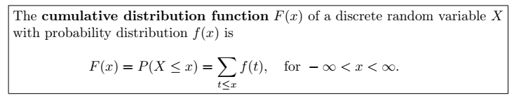
Cumulative Distribution Function
Suppose a coin is tossed 3 times and X = No. of heads.

Slide 7
Example # 01
Consider the following pmf: f(x) = (x/6), x = 1, 2, 3, zero elsewhere
Find distribution function and its graph.
Calculate P(1.5 < x ≤ 4.5)
Notes:
(i) (x<1), (1 ≤x < 2), (2 ≤ x < 3), (x ≥3)
(ii) P(1.5 < x ≤ 4.5) = F(4.5) – F(1.5) = 1 – 1/6 = 5/6

Slide 8
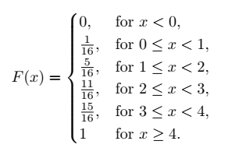
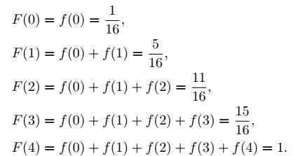
Example # 02
Find P (x = 2) = f(2)
Notes:
f(2) = F(2) – F(1) = 11/16 – 5/16 = 3/8

Slide 9
Example # 03 & 04
(3) Consider the following functions
(i) f(x) = (x +2) / 5 for x = 1, 2, 3, 4, 5.
(ii) f(x) = (4Cx) / (2^5), for x = 0, 1, 2, 3, and 4.
and check whether the functions can serve as a pmf ?
(4) A coin is biased so that a head occurs 3 times of tail. If the coin is tossed 3 times, find the probability distribution for the number of heads and also find P (1 ≤ x ≤ 3).
Notes:
(4): x = 0 (1/64), 1 (9/64), 2 (27/64), 3 (27/64) & P (1 ≤ x ≤ 3). = 63/64

Slide 10
Example # 05 & 06
If two dice are rolled once, find the pmf of the sum of points on two dice and also find c. d. f (also its graph).
A fair coin is tossed until a “Head” appears for the first time. Find
(a) p. m. f
(b) distribution function
(c) F(4)
Notes:
f(z) = 1/36, 2/36, 3/36, 4/36, 5/36, 6/36, 5/36, 4/36, 3/36, 2/36, 1/36
(6) F(4) = 15/16 F(5) = 31/32 F(4) = 1/32

Slide 11
Example # 07
The distribution function for a discrete random variable x is given as:
F(x) = 1 – (1/2)^(x+1), for x = 0, 1, 2, …..
Find:
P (X = 3)
P (7 ≤ x < 10)
Probability Mass Function.
Notes:
P(3) = F(3) – F(2) = 1/ 16
(b) F(9) – F(6) = 7/2^10
(c) f(x) = F(x) – F(x-1) = (1/2)^(x+1) for x = 0, 1, 2, …

Slide 12

Example # 08
Notes:
C = 1/30

Slide 13
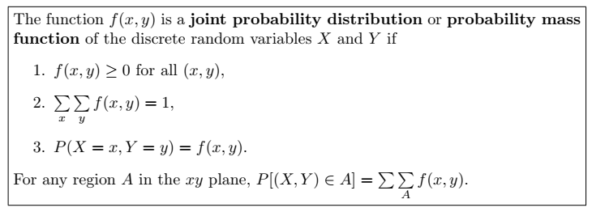
Joint Probability Distribution

Slide 14
Example # 09
Two ballpoint pens are selected at random from a box that contains 3 blue pens, 2 red pens, and 3 green pens. If X is the number of blue pens selected and Y is the number of red pens selected, find
(a) the joint probability function f(x, y)
(b) P[(X, Y ) ∈ A], where A is the region {(x, y)|y ≤ 1}

Slide 15
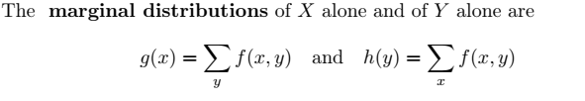

Slide 16
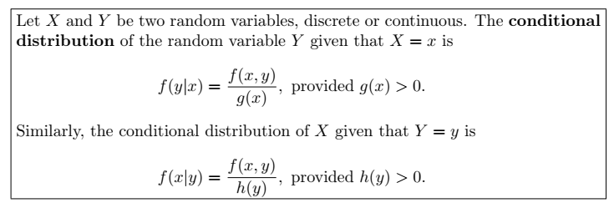

Slide 17
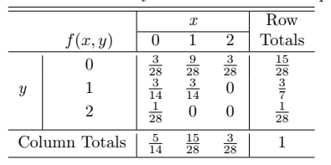
Example 09 (Contd.)
find the conditional distribution of X, given that Y = 1, and use it to determine P(X = 0 | Y = 1).
Notes:
f(0|1) = ½

Slide 18
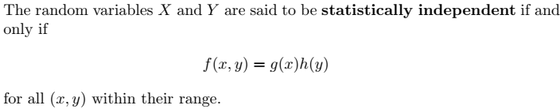
Statistical independence
Show that the random variables of Example 09 are not statistically independent for the point (0, 1).

Slide 19
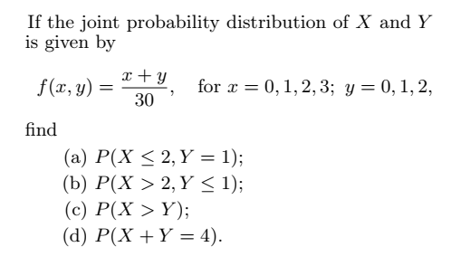
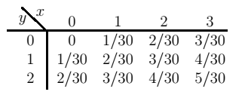
Example # 10
Notes:
(a) 1/5 (b) 7/30 (c)3/5 (d) 4/15

Slide 20
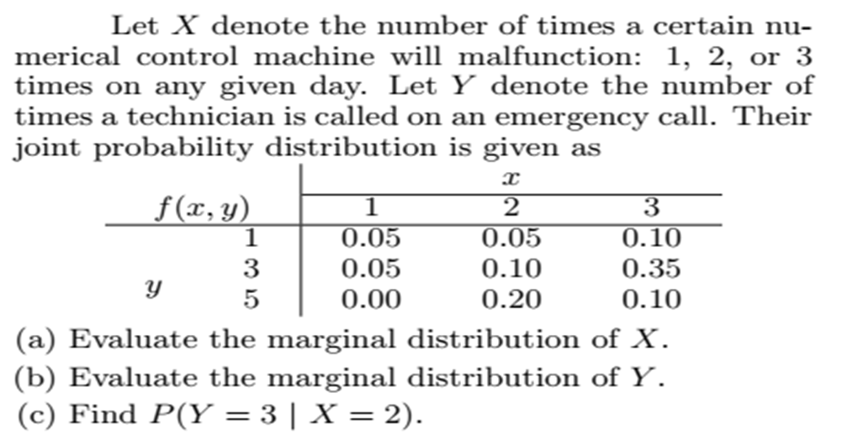
Notes:
(1, ,0.10) (2, 0.35) (3, 0.55) (b) (1, 0.20) (2, 0.50) (3, 0.30)
(c) P(Y=3 given y = 2) = 0.10/0.35=0.285

Slide 21
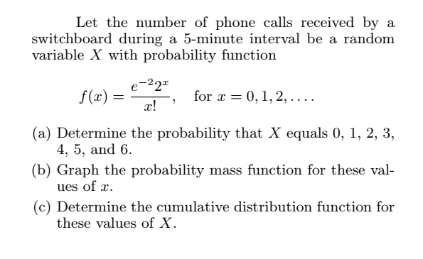
Notes:
(0, 0.1353) (1, 0.2707) ( 2, 0.2707) (3, 0.1804) (4, 0.0902) (5, 0.0361) (6, 0.0120)
(c) (0, 0.1353) (1, 0.4060) (2, 0.6767) (3, 0.8571) (4, 0.9473) (5, 0.9834) (6, 0.9954) (CDF)

Slide 22
Continuous Probability Distributions
A continuous random variable has a probability of 0 of assuming exactly any of its values.
Because we are dealing with an interval rather than a point value of our random variable.
It does not matter whether we include an endpoint of the interval or not. For example:
Its probability distribution cannot be given in tabular form.
f(x) is usually called the probability density function.
Areas will be used to represent probabilities.

Slide 23
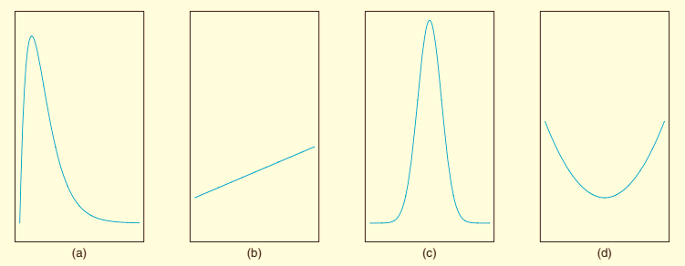
Some graphs of Density Functions
A probability density function is constructed so that the area under its curve bounded by the x axis is equal to 1 when computed over the range of X.

Slide 24
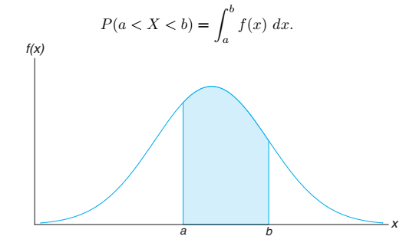
The probability that X assumes a value between a and b is equal to the shaded area

Slide 25
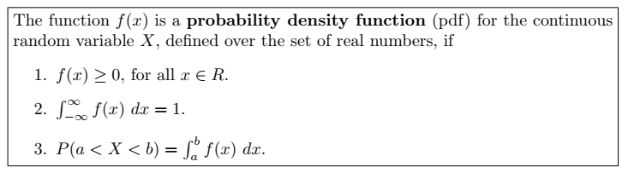
Function to be PDF

Slide 26
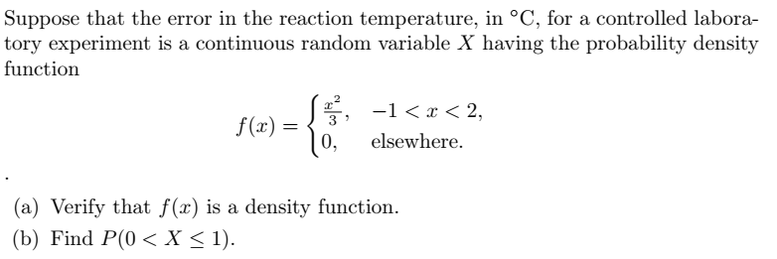
Example # 01

Slide 27
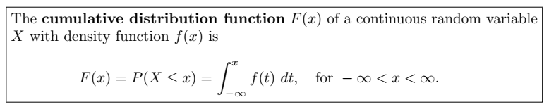

CDF for Continuous RV
As an immediate consequence of the above Definition, one can write the two results:

Slide 28
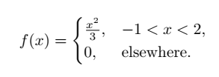
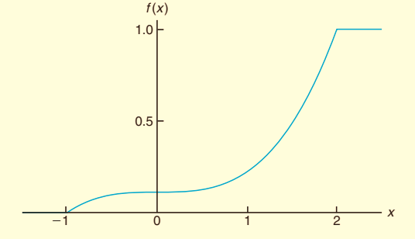
Example # 02
For the density function of previous example , find F(x), and use it to evaluate P(0 < X ≤ 1).
Notes:
P(0 < X < 1) = F(1) – F(0) = 1/9

Slide 29

Example # 03
The Department of Energy (DOE) puts projects out on bid and generally estimates what a reasonable bid should be. Call the estimate b. The DOE has determined that the density function of the winning (low) bid is:
Find F(y) and use it to determine the probability that the winning bid is less than the DOE’s preliminary estimate b.
Notes:
F(y) = 5y/8b - ¼ P(Y < b) = F (b) = (5/8) – (1/4) = 3/8.

Slide 30
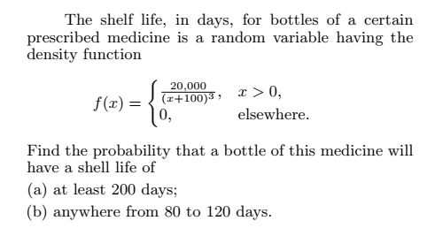
Example # 04
Notes:
(a) P(X > 200) = integrate (200 to infinity) f(x) dx = 1/9 (b) P (80 < x < 200) = 1000/9801 = 0.1020.

Slide 31
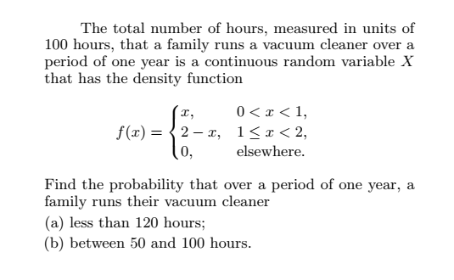
Example # 05
Notes:
(a) 120/100 = 1.2, P(X<1.2) = P(X< 120) = 0.68 (b) P(50 < x < 100) = (0.5 < X < 1) = 0.375

Slide 32
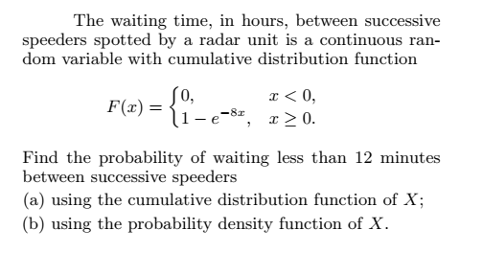
Example # 06
Notes:
(a) P(X < 0.2) = F(0.2) = 1 – exp(-1.6) = 0.7981 (b) f(x) = F’(x) =8exp(-8x), so P(x< 0.2) = 0.7981

Slide 33
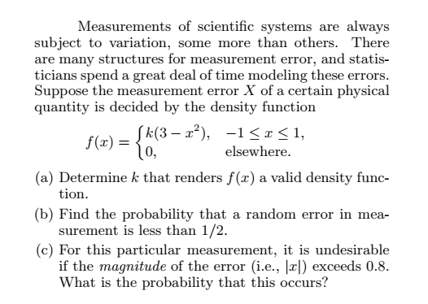
Example # 07
Notes:
(a) K = 3/16 (b) P(X < 0.5) = 99/128 = 0.7734 (c) P( |x| < 0.8) = P(X < -0.8) + P(X> 0.8) = F(-0.8) + 1 – F(0.8) = 0.164 where F(x) = 0.5 +(9/2)x – x^3/16

Slide 34
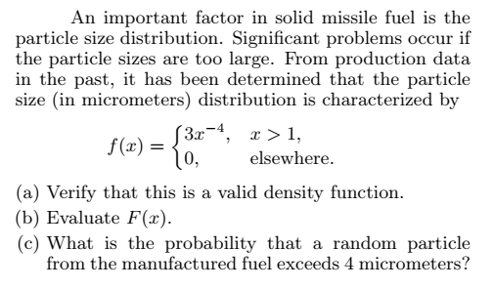
Example # 08
Notes:
(a) This is a pdf (b) F(x) = 1 – x^(-3) (c) P(X>4) = 1 – F(4) = 0.0156

Slide 35
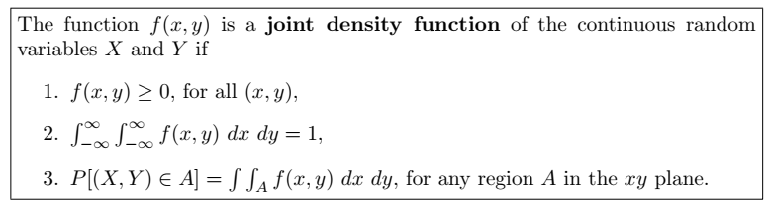
Joint Density Function for Continuous variable

Slide 36

Example # 09
A privately owned business operates both a drive-in facility and a walk-in facility. On a randomly selected day, let X and Y , respectively, be the proportions of the time that the drive-in and the walk-in facilities are in use, and suppose that the joint density function of these random variables is
(a) Verify for PDF? (b) Find P [(X, Y ) ∈ A], where A = {(x, y) | 0 < x < 1/2, 1/ 4 < y < 1/2}.
Notes:
(a) This is a pdf (b)

Slide 37
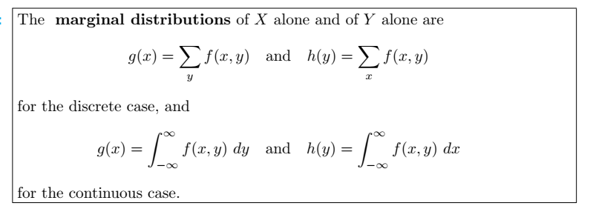
Marginal distribution for Continuous Variable

Slide 38
Example # 10
Find g(x) and h(y) for the joint density function of previous Example?
Notes:
g(x) = (4x+3)/5 h(y) = 2(1+3y)/5

Slide 39
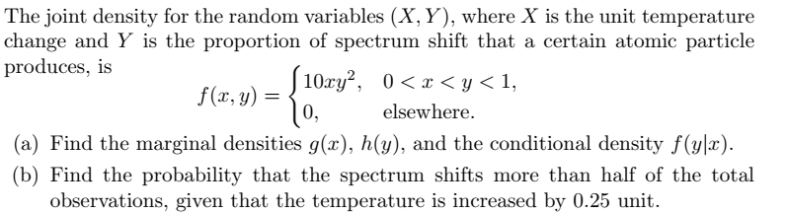
Example # 11
(c) Calculate: E(x), E(Y), E(xy)
Notes:
g(x) = (10/3)*x*(1-x^4) for 0 < x < 1 h(y) = 5y^4, for 0<y<1 (b) P(Y>0.5 | x = 0.25) = 8/9

Slide 40
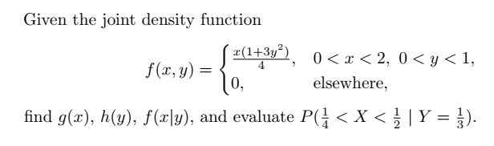
Example # 12
Notes:
G(x) = x/2 h(y) = (1+3y^2)/2 P(x|y=1/3) = 3/64 f(x|y) = x/2

Slide 41
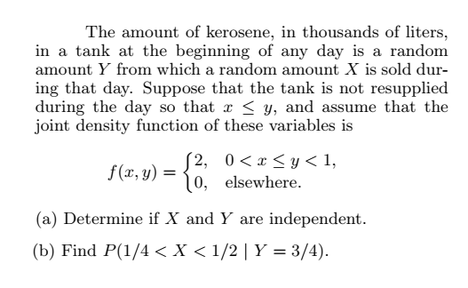
Example # 13
Notes:
No independent (b) 1/3

Slide 42
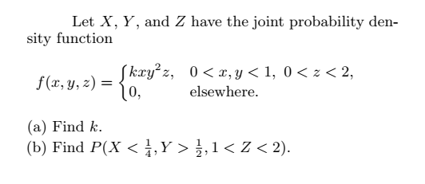
Example # 14
G(x,y), G(x,z), G(y,z), G(x), E(x) =?
Notes:
K = 3 (b) 21/512 = 0.04

Slide 43
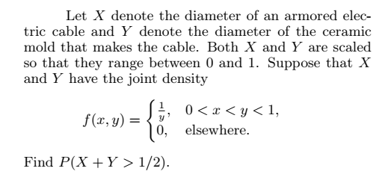
Example # 15
Notes:
X=[0, ¼] y= [ x ,0.5-x]

Slide 44
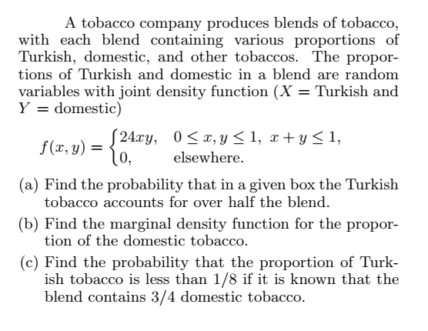
Example # 16
Notes:
P(X>0.5) = Integrate(0, 1-x) g(x) dy. = 5/16=0.3125
H(y) = Integrate (0, 1-y) 24xydx = 12y(1-y)^2
P(X<1/8 | Y = ¾) = 0.25

Slide 45
Example # 17
A salesperson for a medical device company has two appointments on a given day. At the first appointment, he believes that he has a 70% chance to make the deal, from which he can earn $1000 commission if successful. On the other hand, he thinks he only has a 40% chance to make the deal at the second appointment, from which, if successful, he can make $1500. What is his expected commission based on his own probability belief? Assume that the appointment results are independent of each other.
Notes:
f(0) = (1- 0.7)(0.4) = 0.18 f(2500) = 0.7(0.4) = 0.28 f(1000) = (0.7)(1-0.4) = 0.42 f(1500) = (1-0.7)(0.4) = 0.12
E(x) = $1300.

Slide 46
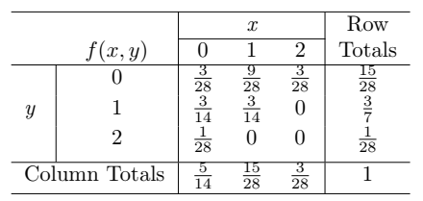
Example # 18
Let X and Y be the random variables with joint probability distribution indicated in Table below. Calculate E(XY).
Also calculate E(XY), E(x), E(y), V(x), V(y), Covariance (X, Y), correlation.
Notes:
E(XY) = 3/14

Slide 47
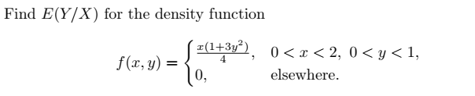
Example # 19
Also calculate E(XY), E(x), E(y), V(x), V(y), Covariance (X, Y), Correlation.
Notes:
E(y/x) = 5/8

